Slide 1
Trends in electricity production
vs.
Economic growth
Data Engineering 1
Naida Dzigal
December 10th 2022

Slide 2
Outline
Aim of project
How to find the answer using limited analytics available in Knime
Knime pipeline
Plots 1990 vs. 2010
Trends in Nuclear
Trends in oil, gas and coal
GDP-PPP versus population size
Conclusions

Slide 3
Aim of project
To investigate if population growth is the main driver in an increased oil, gas and coal diet worldwide from 1990-2010.

Slide 4
How?
Plot
Electricity production for nuclear, oil, gas and coal in year 2010 (comparison: has nuclear changed as much?)
GDP-PPP versus population size in the year 2010
Compare to 1990 to provide context
Explain
Are there trends?
What conclusions can be drawn, if any?

Slide 5
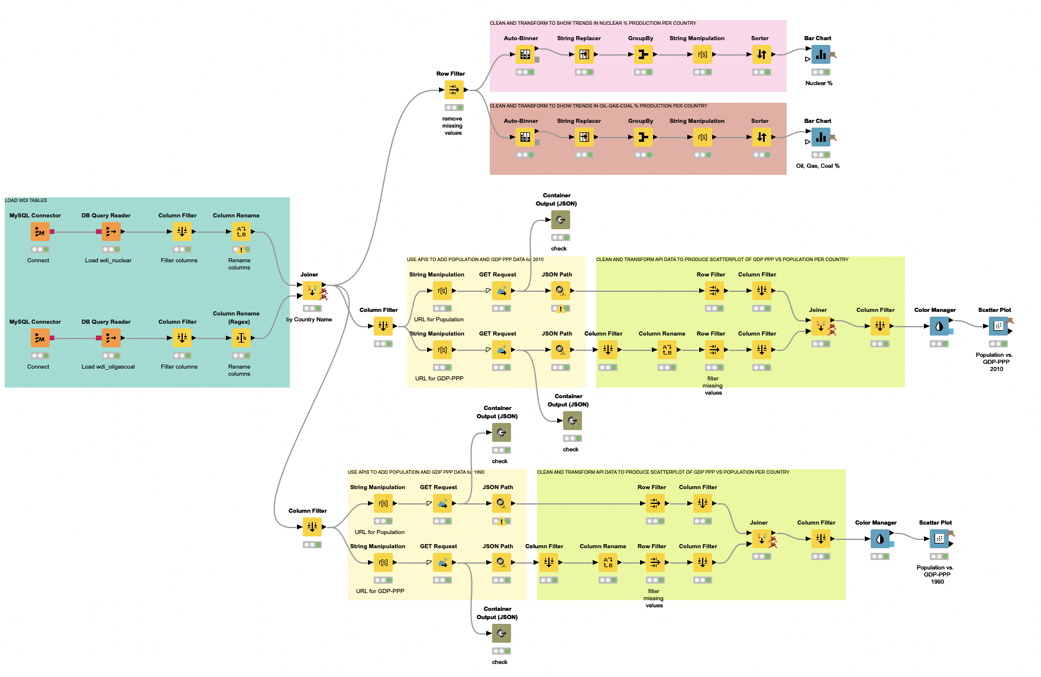
Knime pipeline

Slide 6
Barcharts
Load data
Scatterplots
Knime pipeline

Slide 7
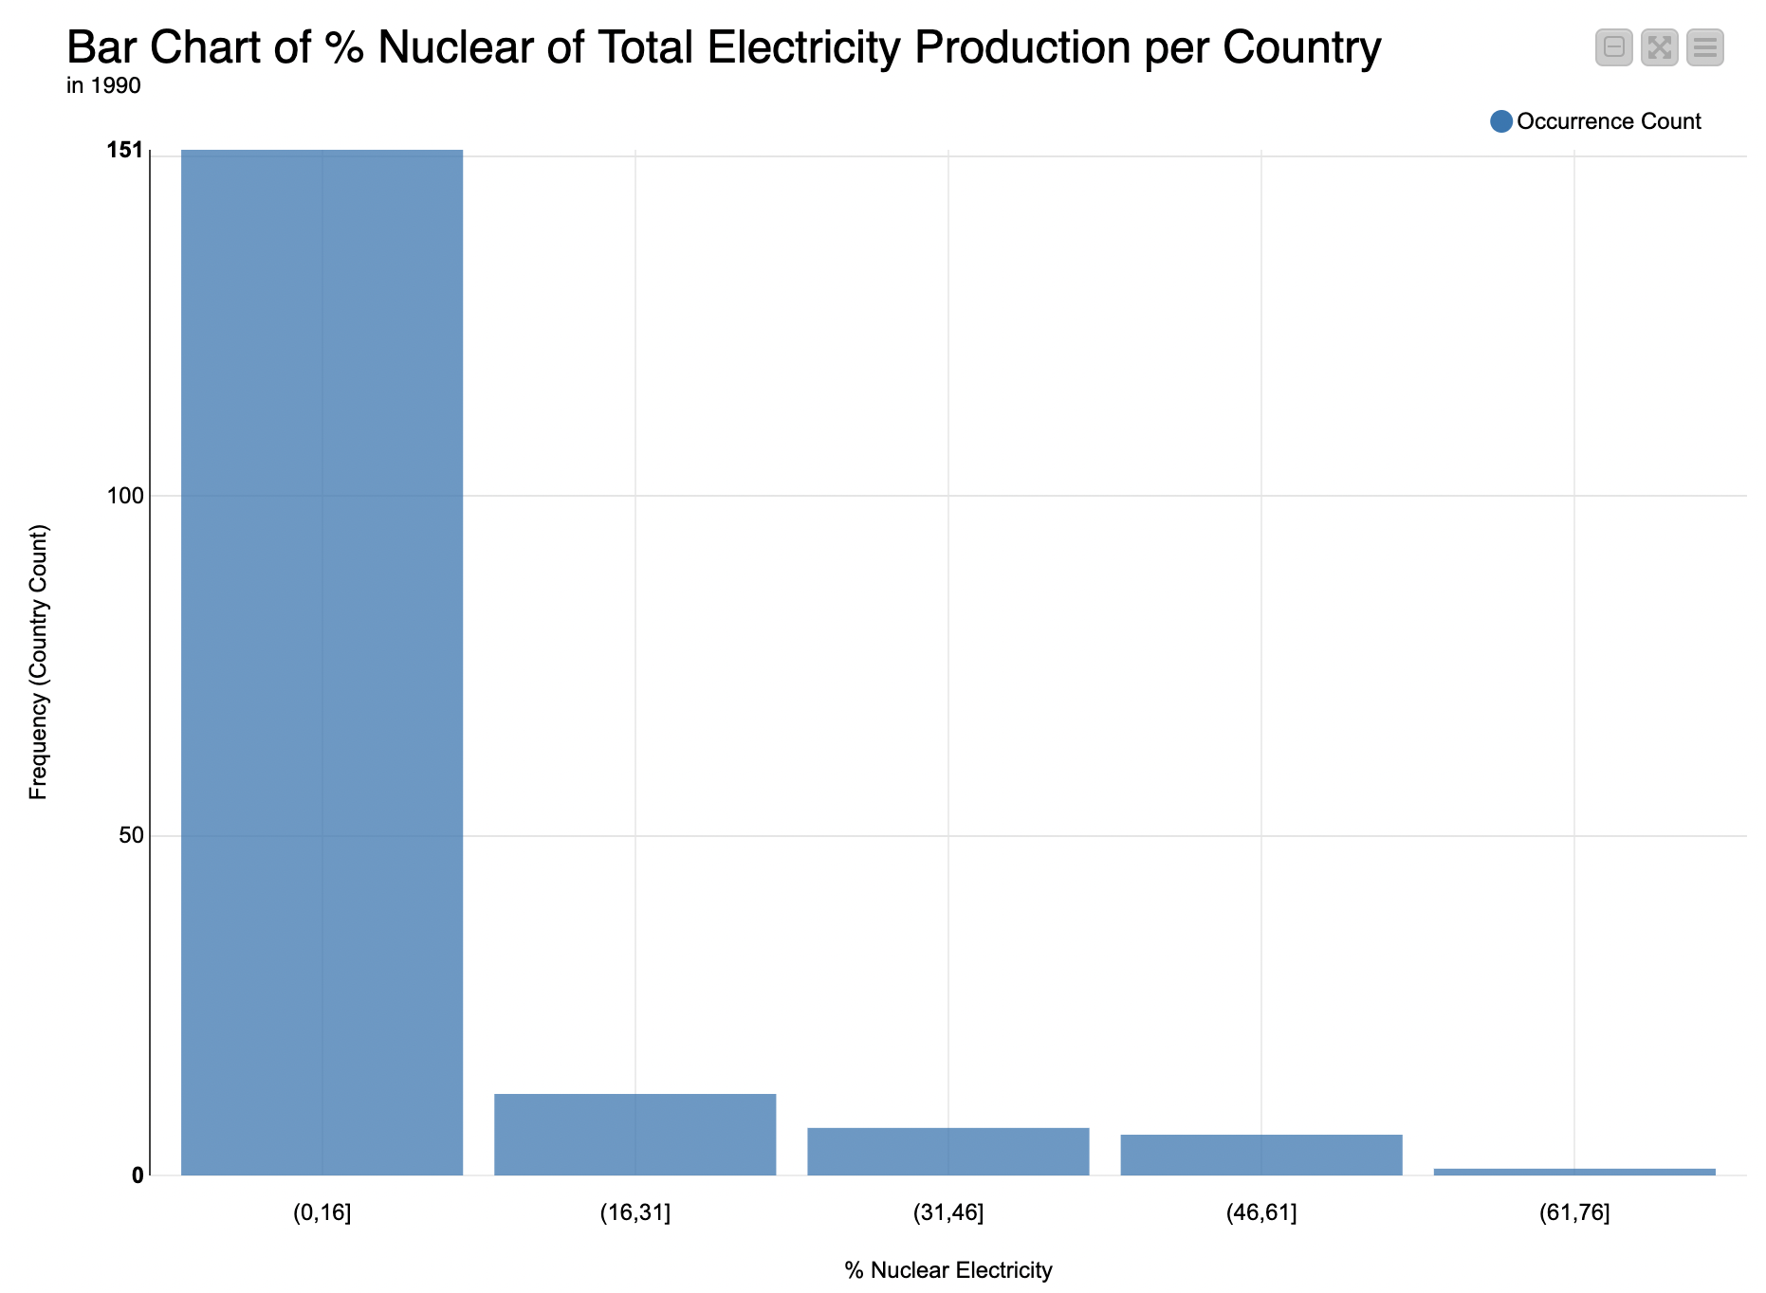
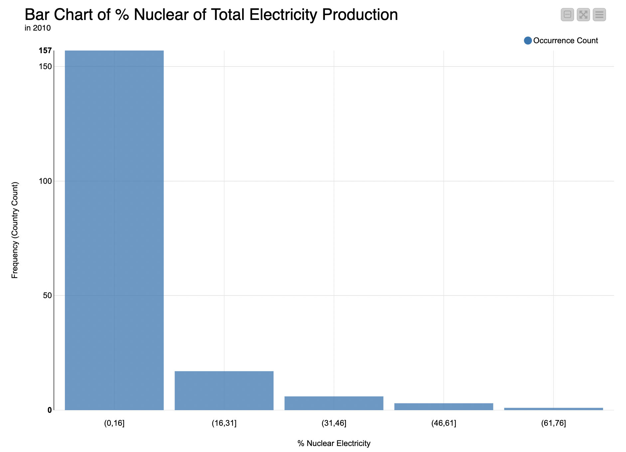
Trends in nuclear 1990-2010

Slide 8
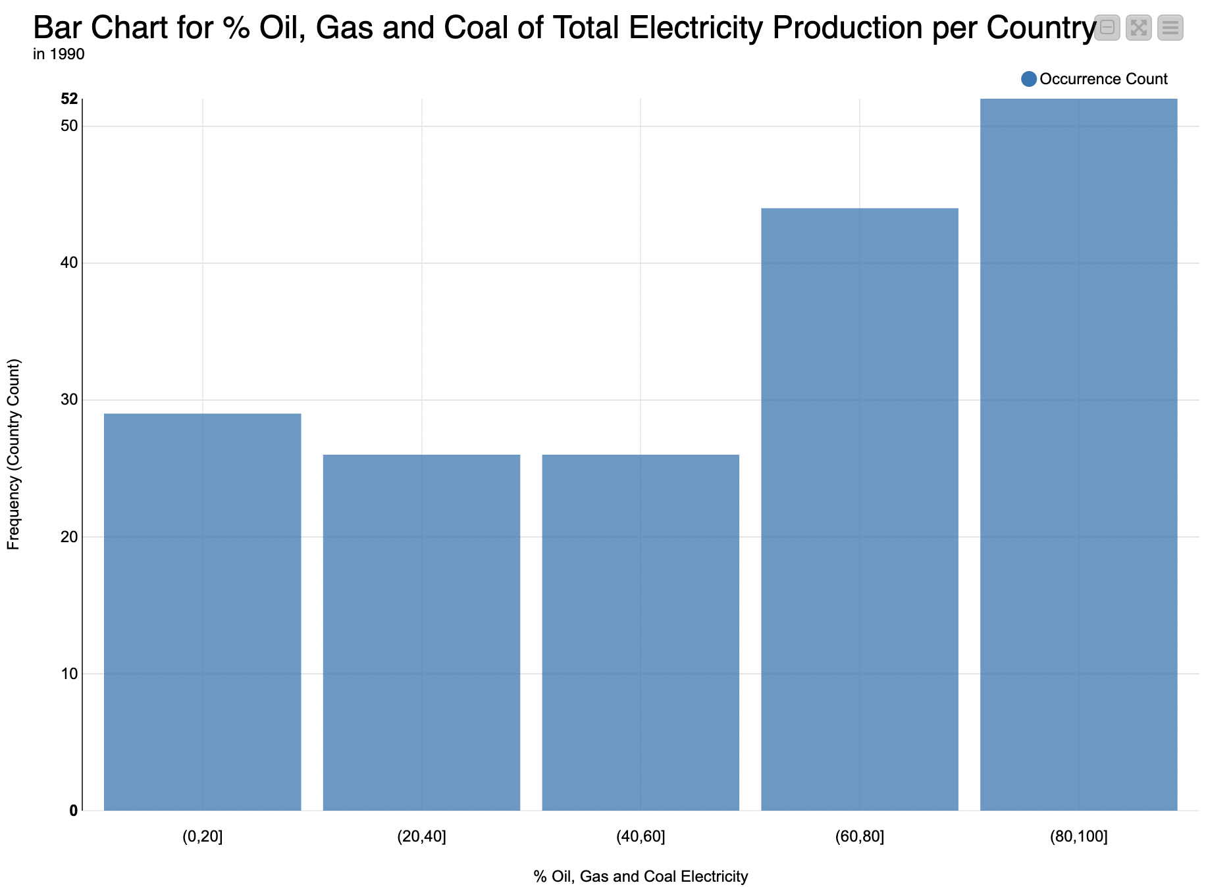
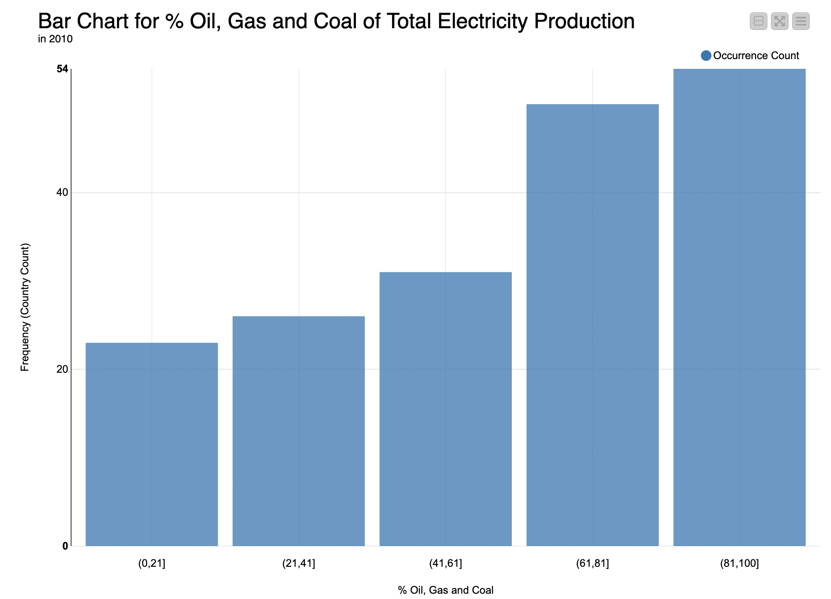
Trends in oil, gas and coal 1990-2010

Slide 9
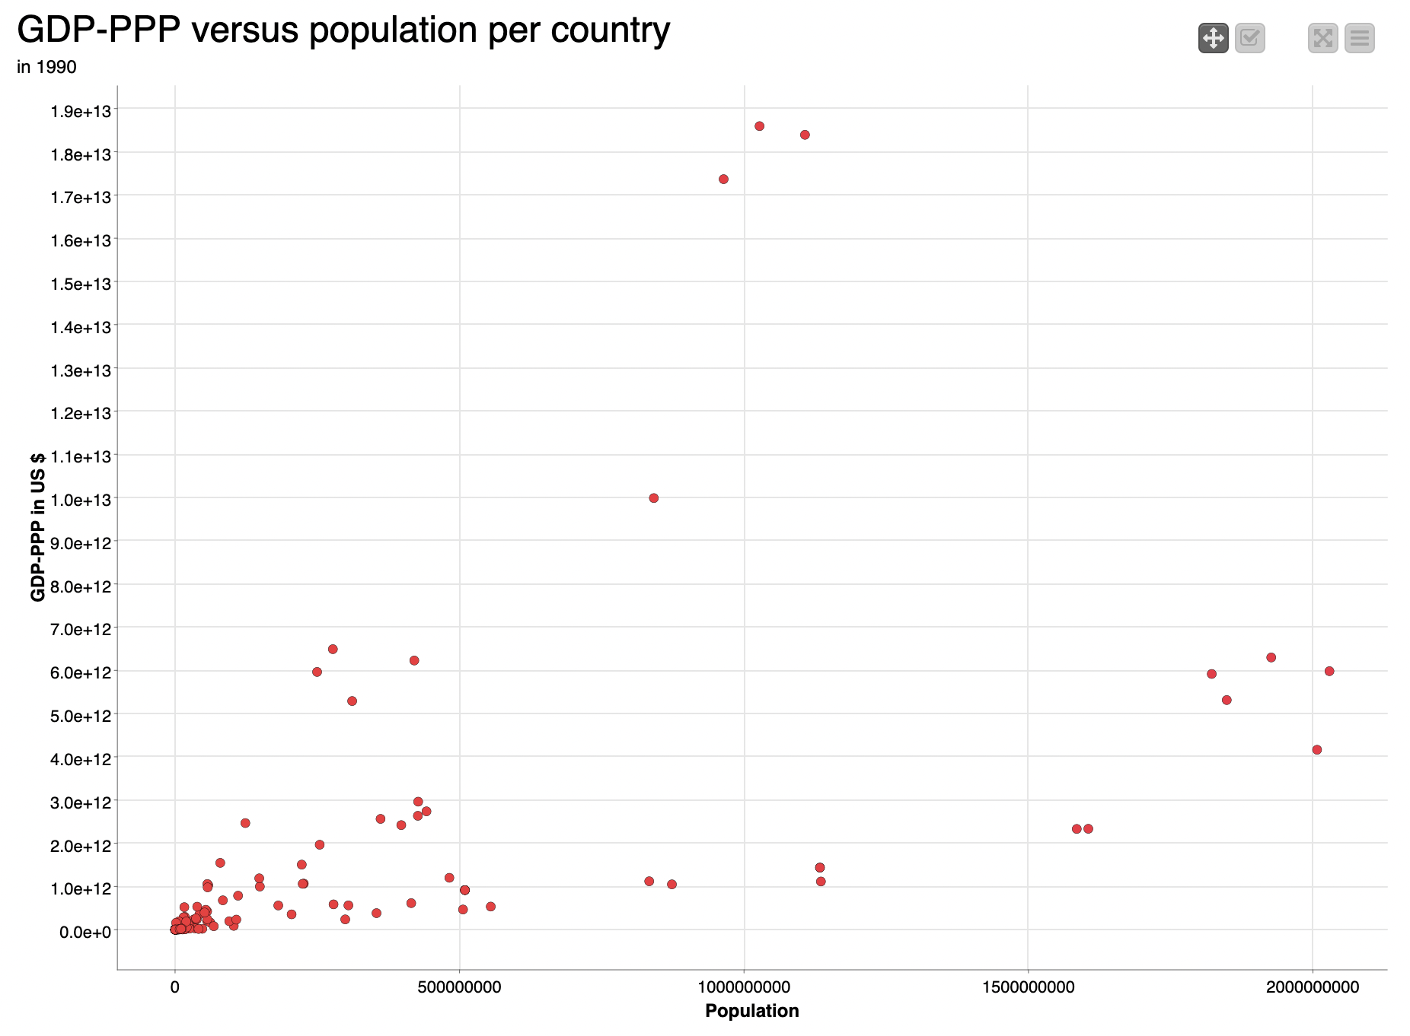
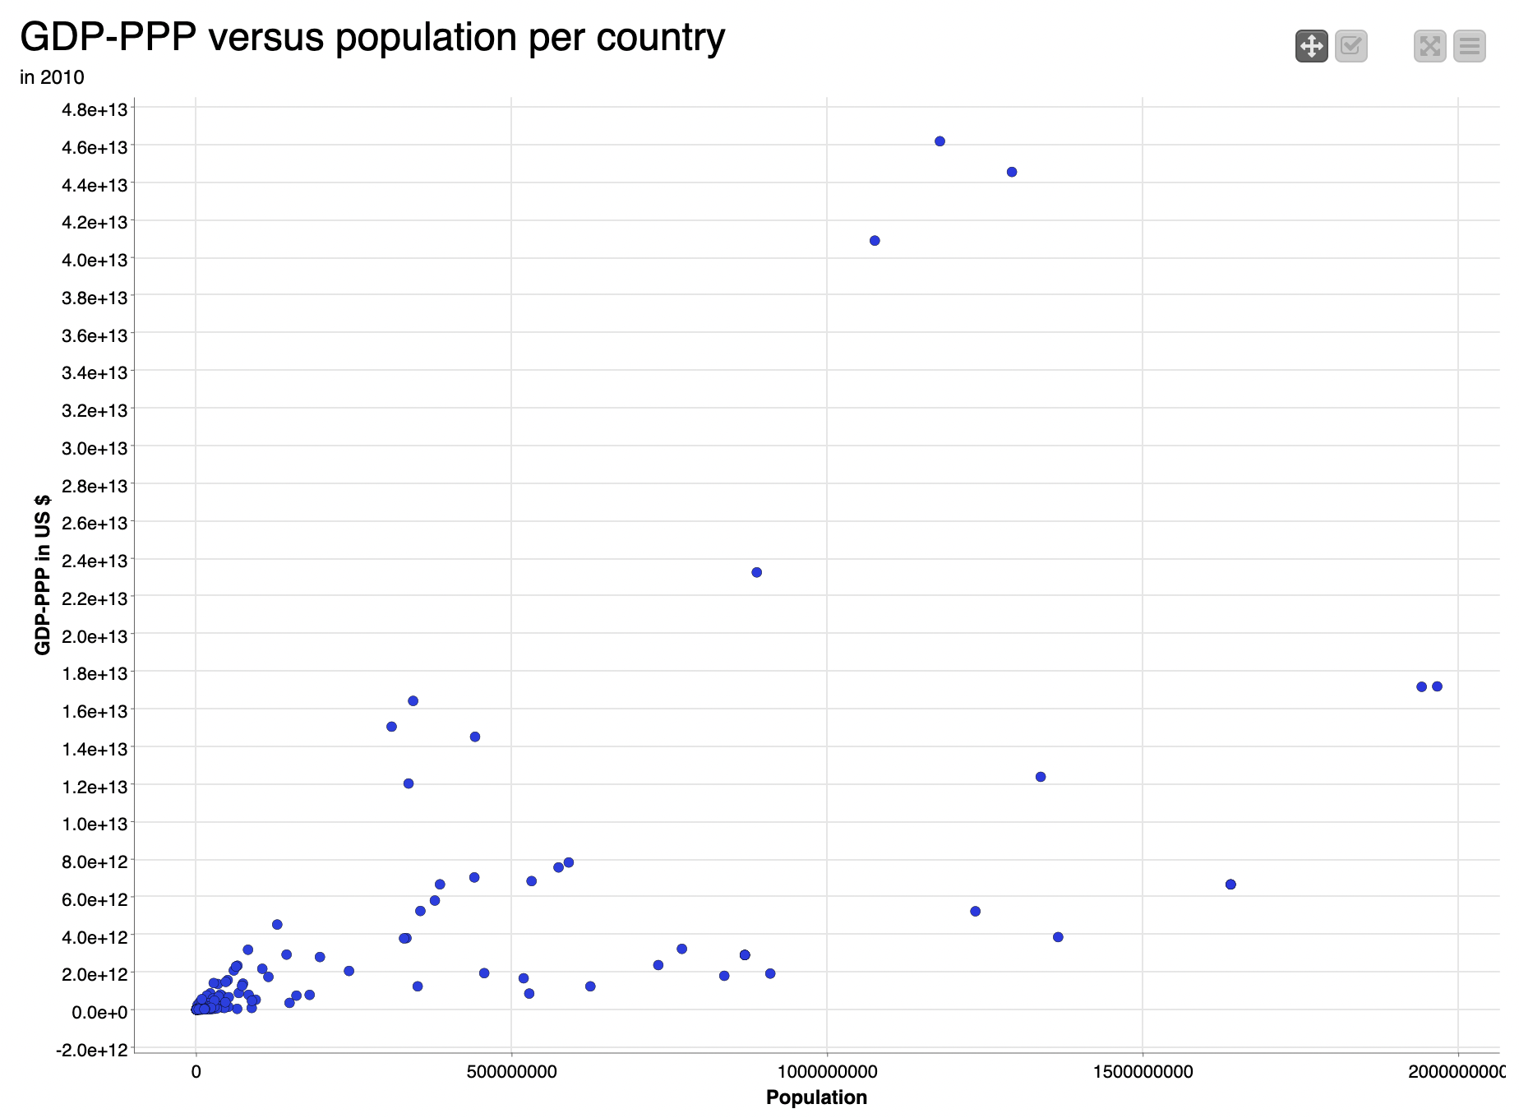
GDP-PPP vs. population growth

Slide 10
GDP-PPP vs. population growth
GDP ~ trippled
more countries with lower GDP growth

Slide 11
Conclusions
Investigation inconclusive: not enough variables (limitation of knime software)
Nuclear electricity production stable in years 1990-2010
Slight increase in oil, gas and coal electricity production in years 1990-2010
GDP-PPP roughly tripled between 1990-2010
Need more investigations into why/how this happened
Population growth not proportional to GDP-PPP growth
Likely not the driving factor for more fossil fuel consumption

